Slide 1

Closing Session
2025

Slide 2
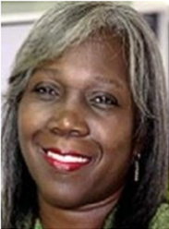
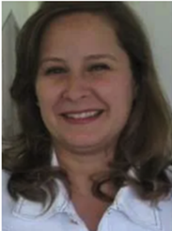
Welcome!
Donna Roper
Program Conference Co-chair
Marcia Cassitas Hino
Program
Conference
Co-chair

Slide 3
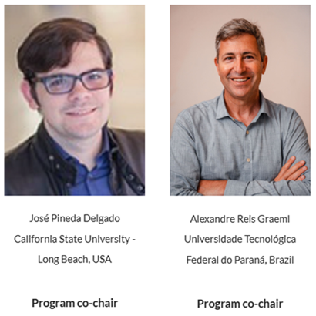
Welcome!
Program Chairs

Slide 4
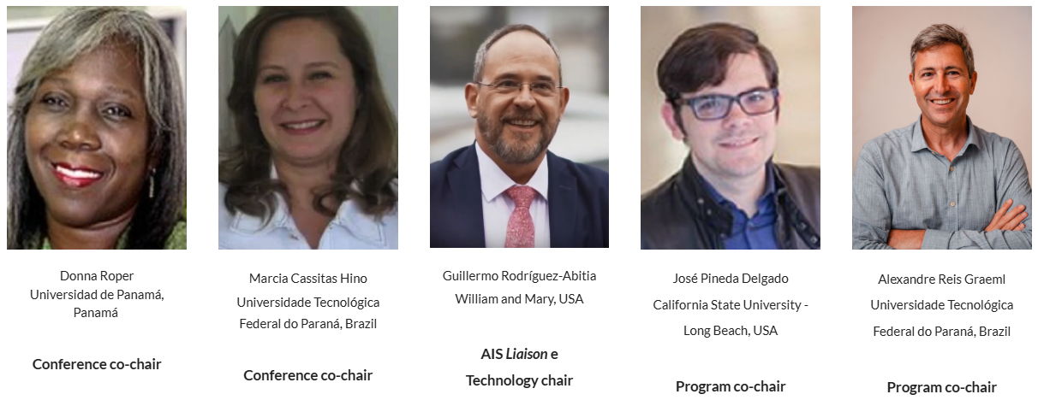
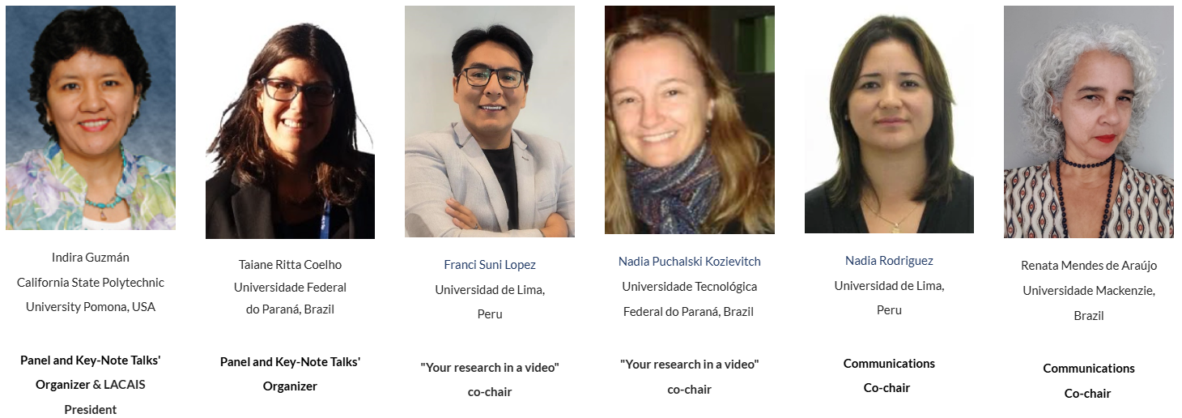
Conference Committee

Slide 5



ISLA 2025 em números
236 Participantes
35% mestres e mestrandos
25% doutores e doutorandos
34%
66%
Membro AIS:
91%
9%

Slide 6
We had…
53 papers submitted
33 accepted (~62%)
8 paper presentation sessions:
29 papers in Portuguese
1 papers in Spanish
3 papers in English
9 research videos selected:
All in Portuguese
59 paper reviewers, who carried out 106 reviews
4 video reviewers, who carried out 36 reviews

Slide 7
Reviewers
Thank You

Slide 8
Your Research in a Video award
Best videos
people’s choice - The authors advertised their videos to colleagues and friends prior to the conference, the ones which got more views and likes
experts’ choice - Decisions were made by a group of 6 academics that were invited for the task

Slide 9
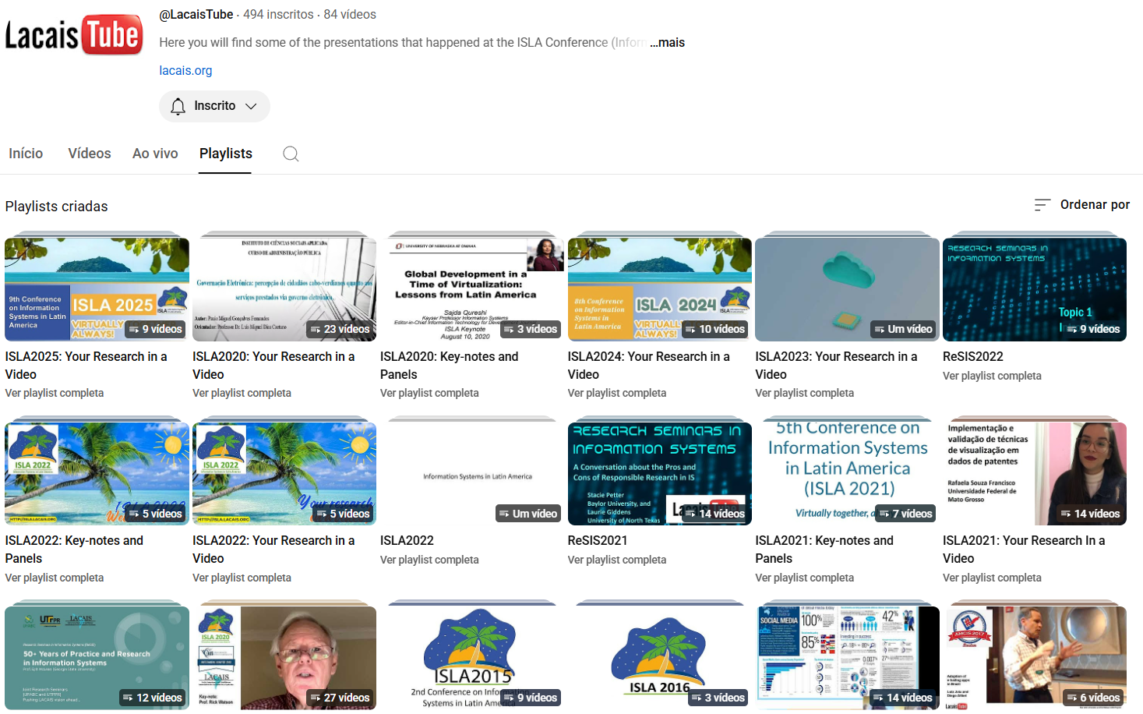
Information Systems in Latin America

Slide 10
Best videos / people’s choice:
the winners are…

Slide 11
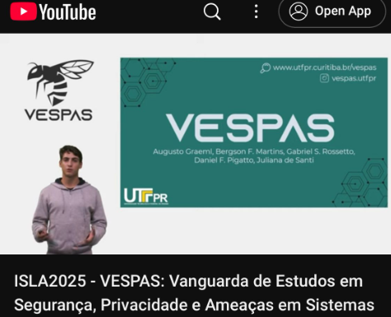
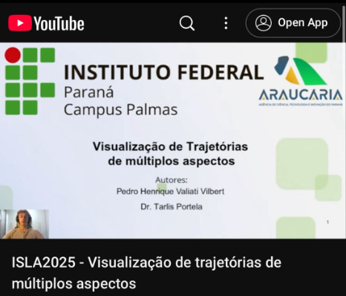
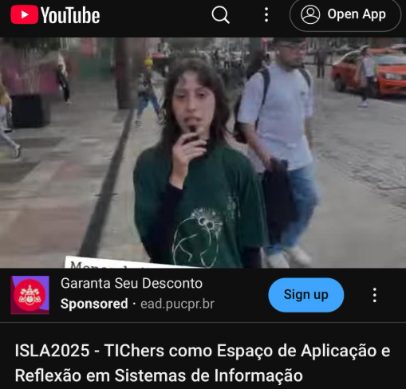
ISLA 2025 - the winners are…
Category people’s choice

Slide 12
Best videos / experts’ choice:
the winners are…

Slide 13
ISLA 2025 - the winners are…
Category expert’s choice

Slide 14

Best Paper Award
ISLA 2025

Slide 15

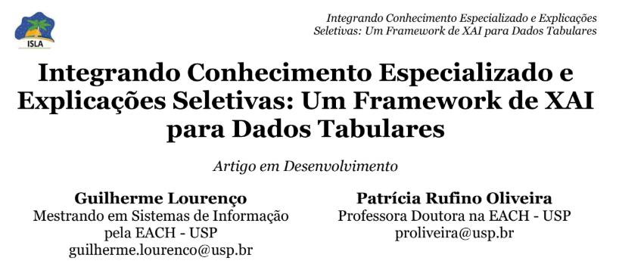
ISLA 2025
Category best paper award
Research in Progress
Booklizer - Um Aplicativo de Recomendação Literária Personalizada Usando GNN Gabriella Silveira Braz, GiovanaLiao, Maria Julia de Pádua, Ivan Carlos Alcântara de Oliveira (Universidade Presbiteriana Mackenzie)
and
Integrando Conhecimento Especializado e Explicações Seletivas: Um Framework de XAI para Dados Tabulares Guilherme Lourenço, Patrícia Rufino Oliveira (Universidade de São Paulo)

Slide 16
ISLA 2025
Category best paper award
Research in Progress

Slide 17
ISLA 2025
Category best paper award
Full paper Bridging Technology and Talent: The Role of Soft Skills in Digital Transformation Processes Diego Fernandes de Souza, Vanessa Martins dos Santos, Tarcísio José Beceveli Junior (FGV)
And
Estrategia de Ciberseguridad FAD (Flexible, Adaptable y Dinámica). El Reto de una Respuesta Activa y Resiliente Jeimy J. Cano M. (Universidad de los Andes)

Slide 18
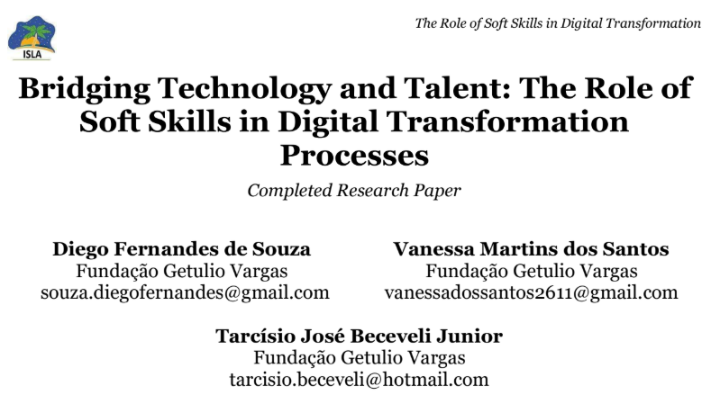
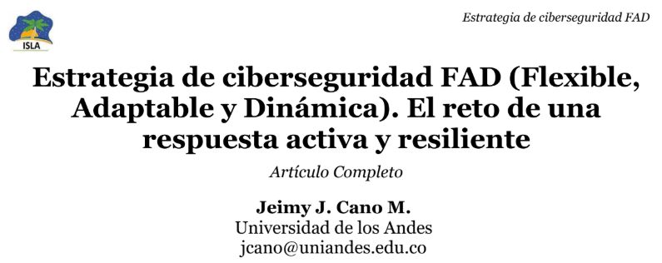
ISLA 2025
Category best paper award
Full paper

Slide 19


We are specially thankful to…
our IS community who embraces ISLA
AIS - for the institutional support and the e-library hosting of our papers
VESPAS - who worked behind the scenes to make sure we had a safe environment for our conference

Slide 20
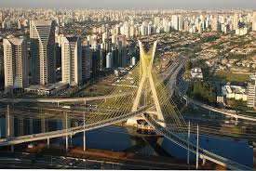
Get involved!
AMCIS 2026: Reno Nevada, August 20-22, 2026
AMCIS 2027
Digital Humanities & Digital Culture
Sao Paulo, Brazil July 28-30, 2027

Slide 21


Get involved!
https://www.lacais.org/

Slide 22

Get involved!
For those interested in participating in the organization of ISLA 2026, please fill the form:

Slide 23
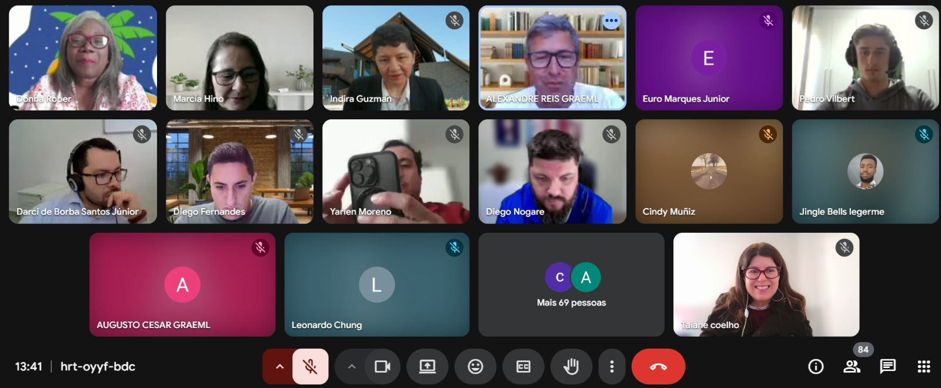
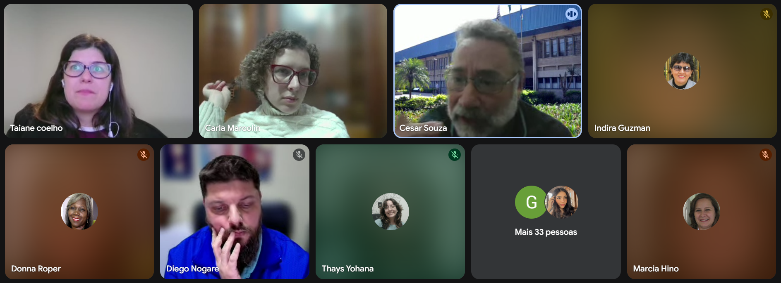
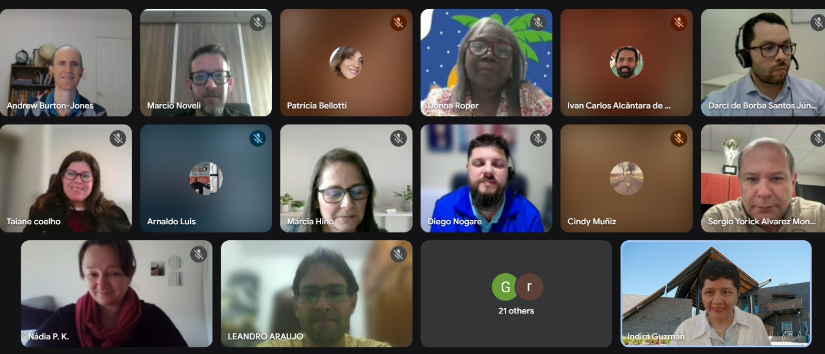
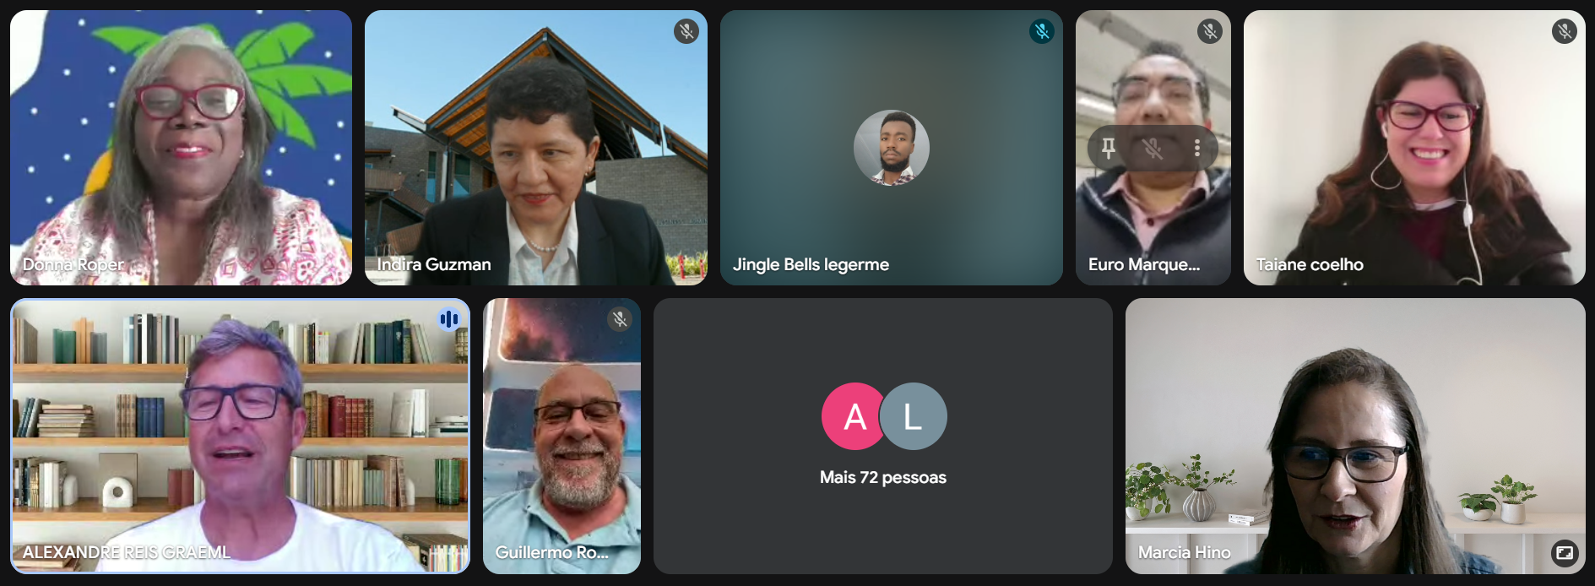
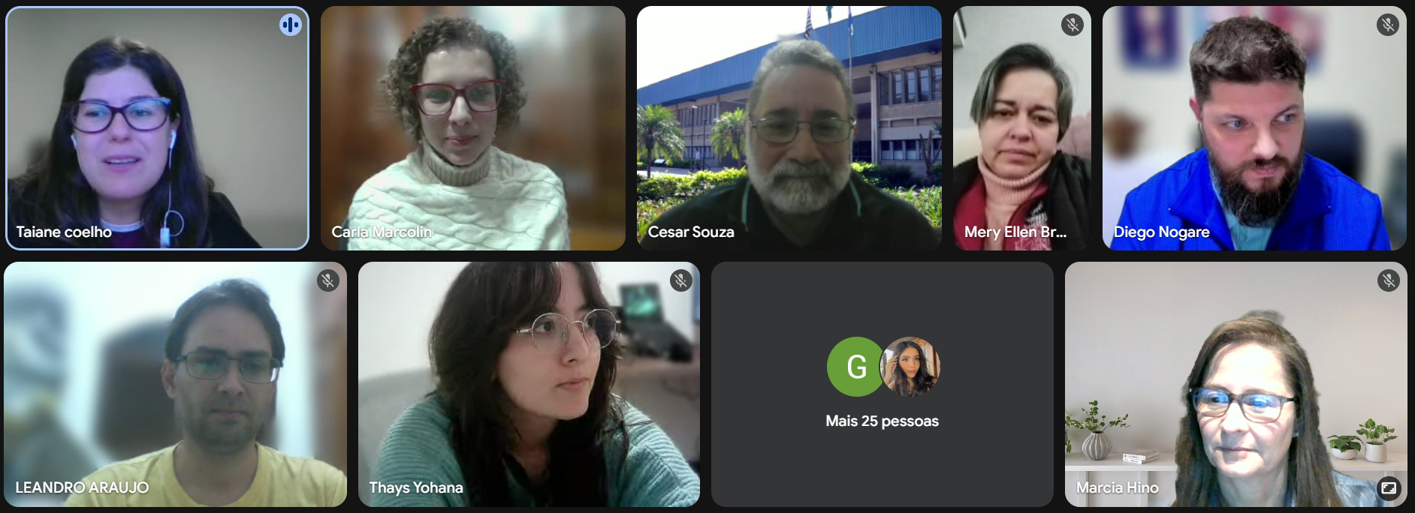
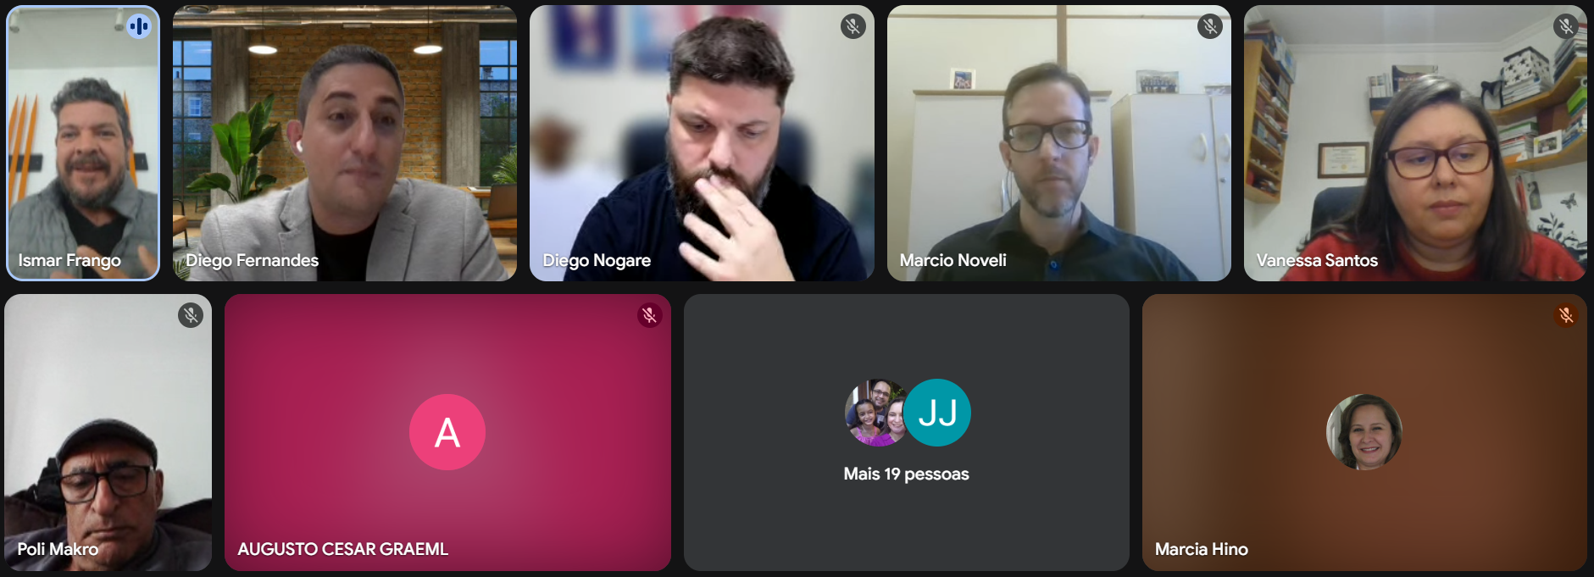
See you in ISLA 2026!

